Slide 1


Slide 2
A QUEST FOR DIAMONDS IN THE LAND OF COAL FIELDS

Slide 3
OPPURTUNITY DANCES WIH THOSE WHO ARE ALREADY ON THE FLOOR
On 21ST Oct 2015, Sankalp-A Pledge to Change entered into a new phase of its realization towards the vision of a literate India when the Volunteers of Sankalp entered into the poverty stricken areas near the coal fields of Kendua Block, Dhanbad district. The team identified around 150-200 underprivileged children who will be enrolled at the upcoming centre. Shantiniketan school classes will be used to to start the centre..

Slide 4
SANKALP BEGINS ITS HISTORIC DHANBAD JOURNEY

Slide 5
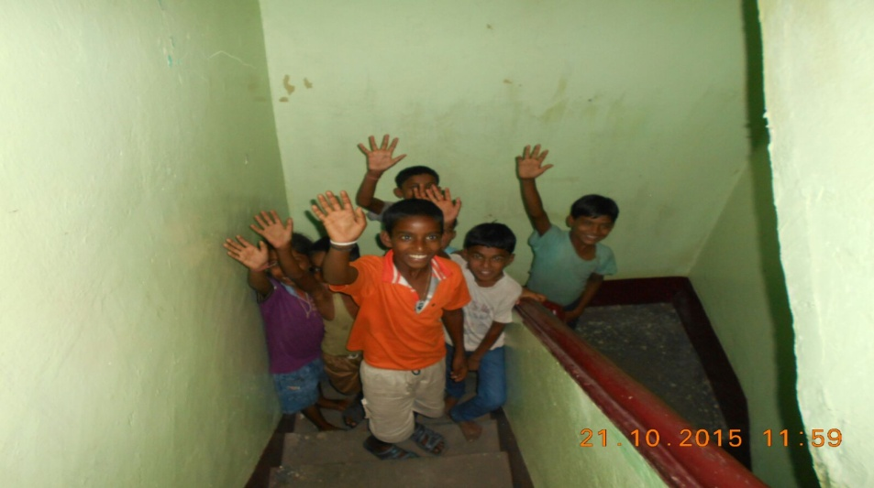
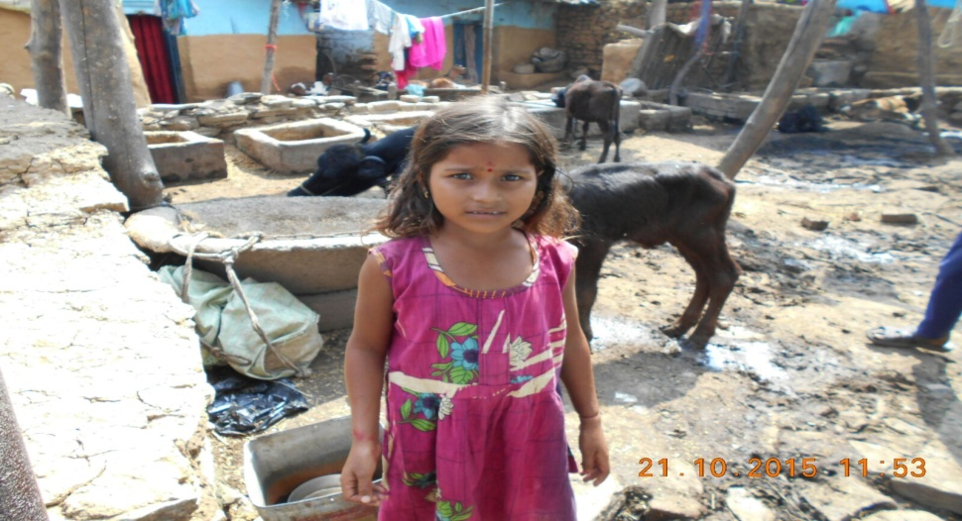
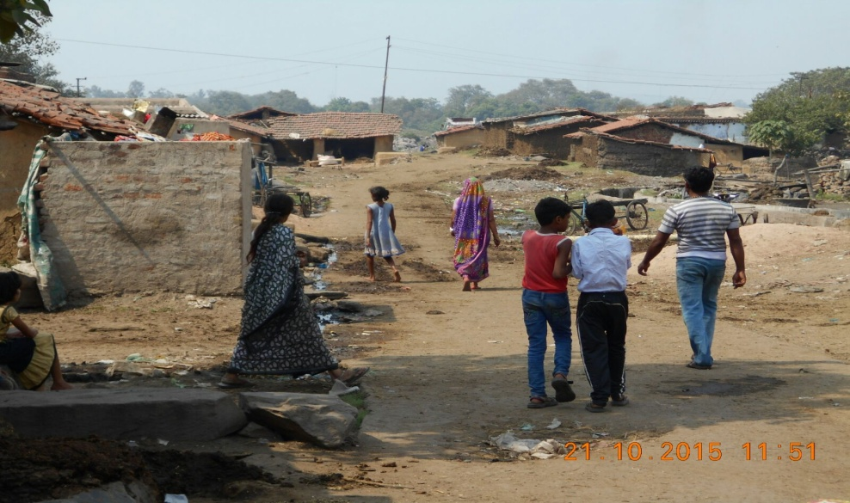
A JOUNEY OF THOUSAND MILES BEGJINS WITH A SMALL STEP

Slide 6
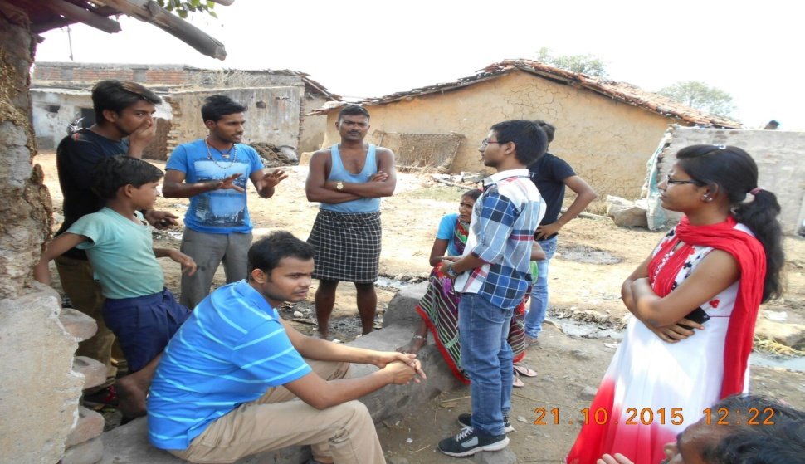
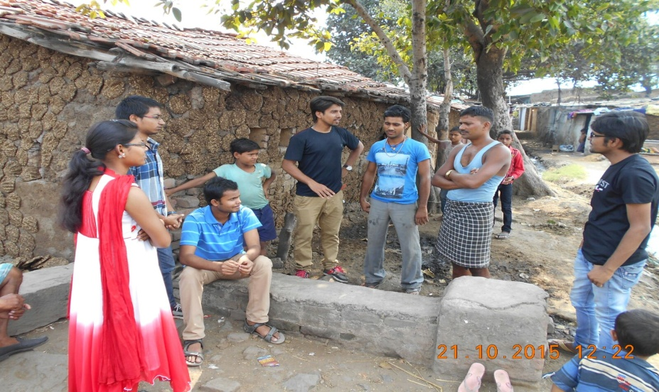
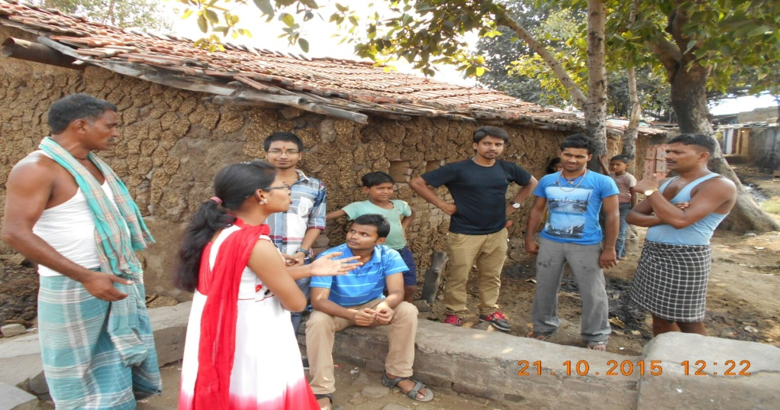
SOWING THE SEEDS OF CHANGE-INTERACTION WITH VILLAGERS

Slide 7


Slide 8

DHANBAD CENTRE
INAUGURATION

Slide 9
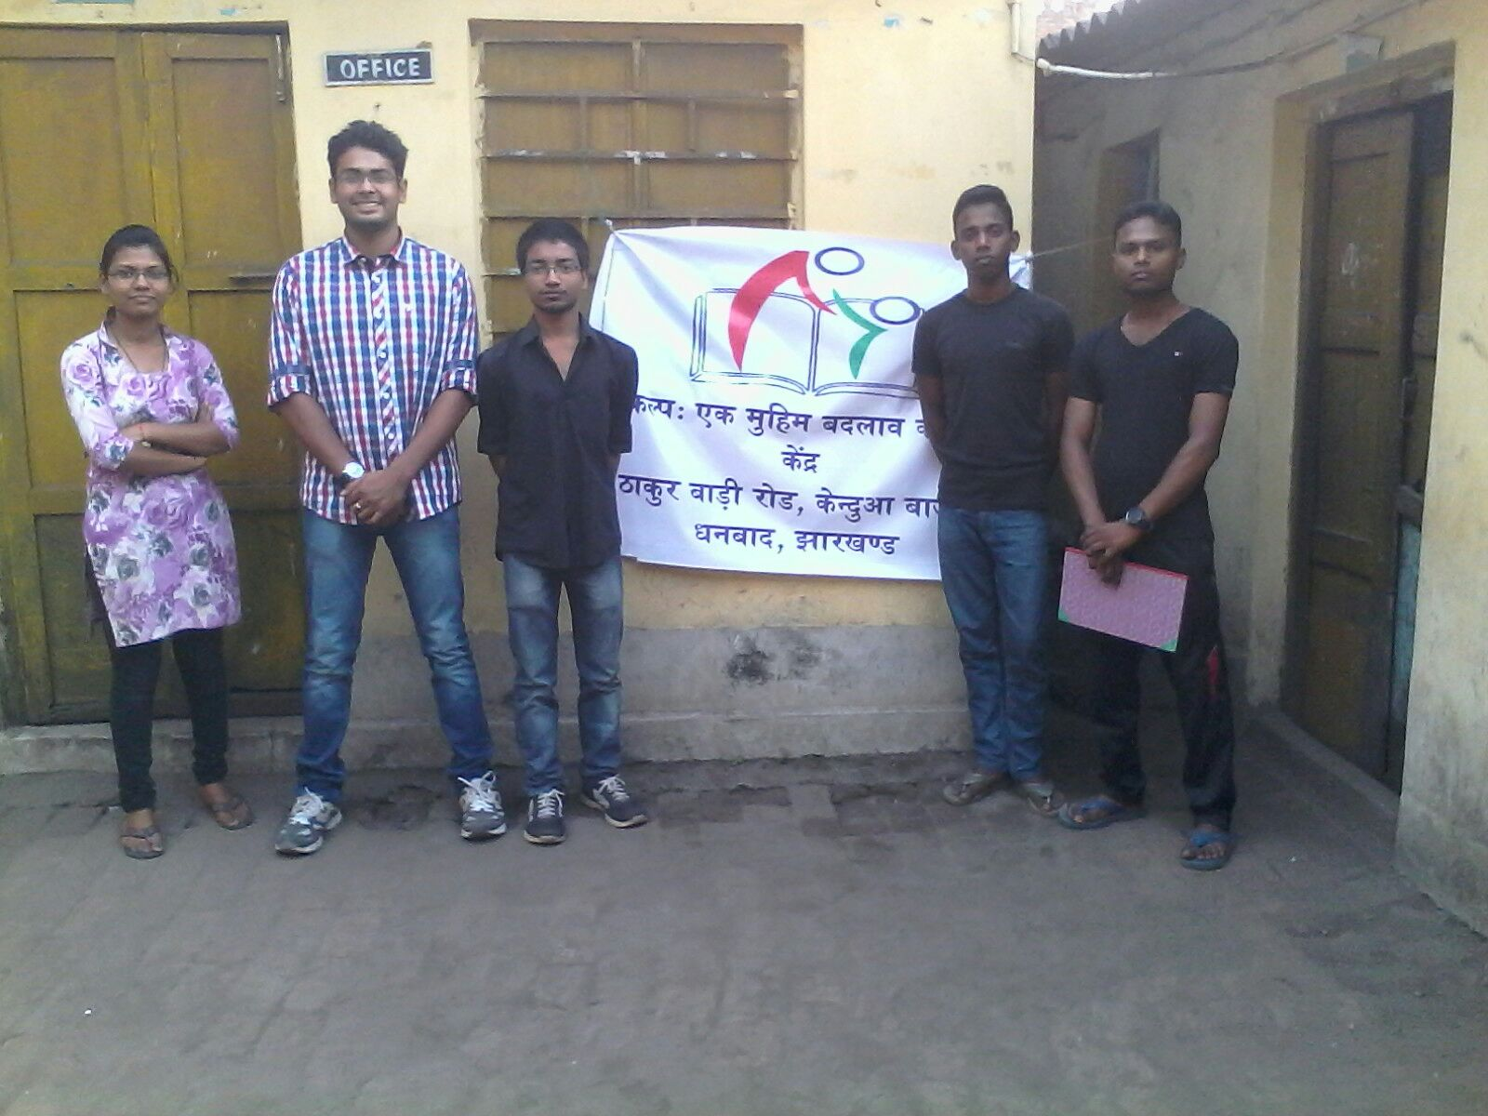
THE FIRST STEP IS ALWAYS THE HARDEST

Slide 10


Slide 11
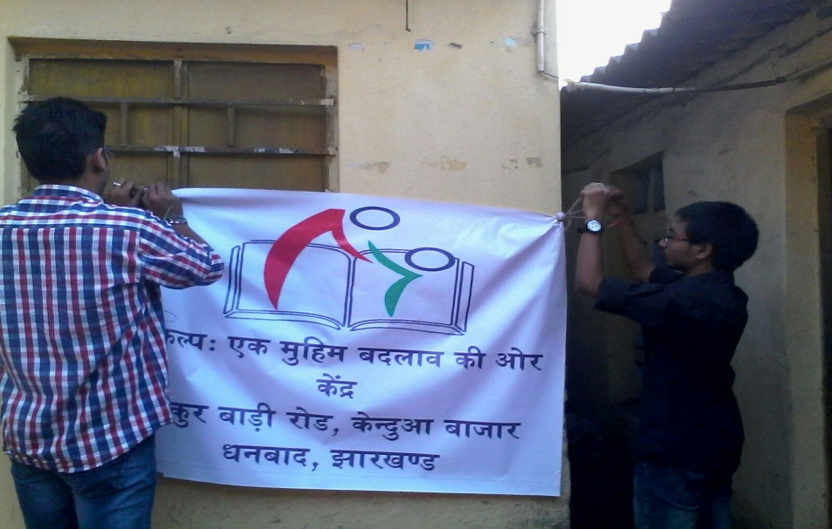
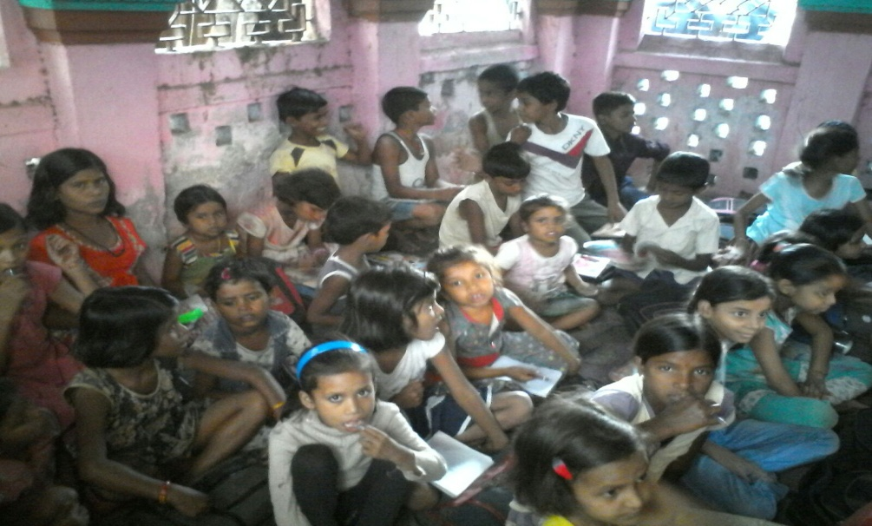
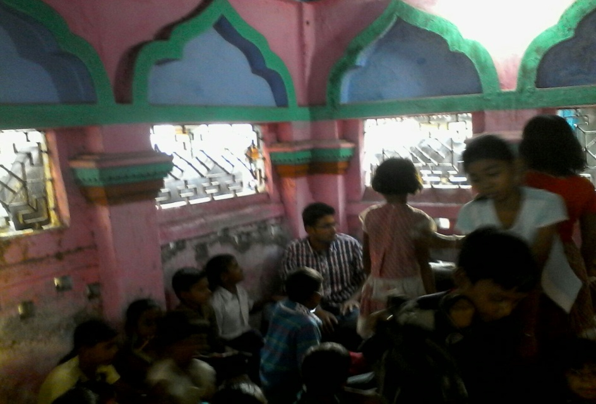
THE BEGINNING OF A NEW DAWN

Slide 12


Slide 13
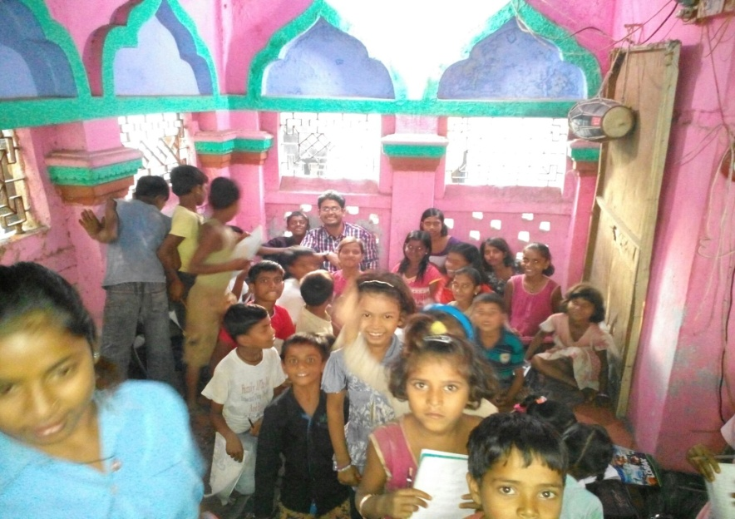
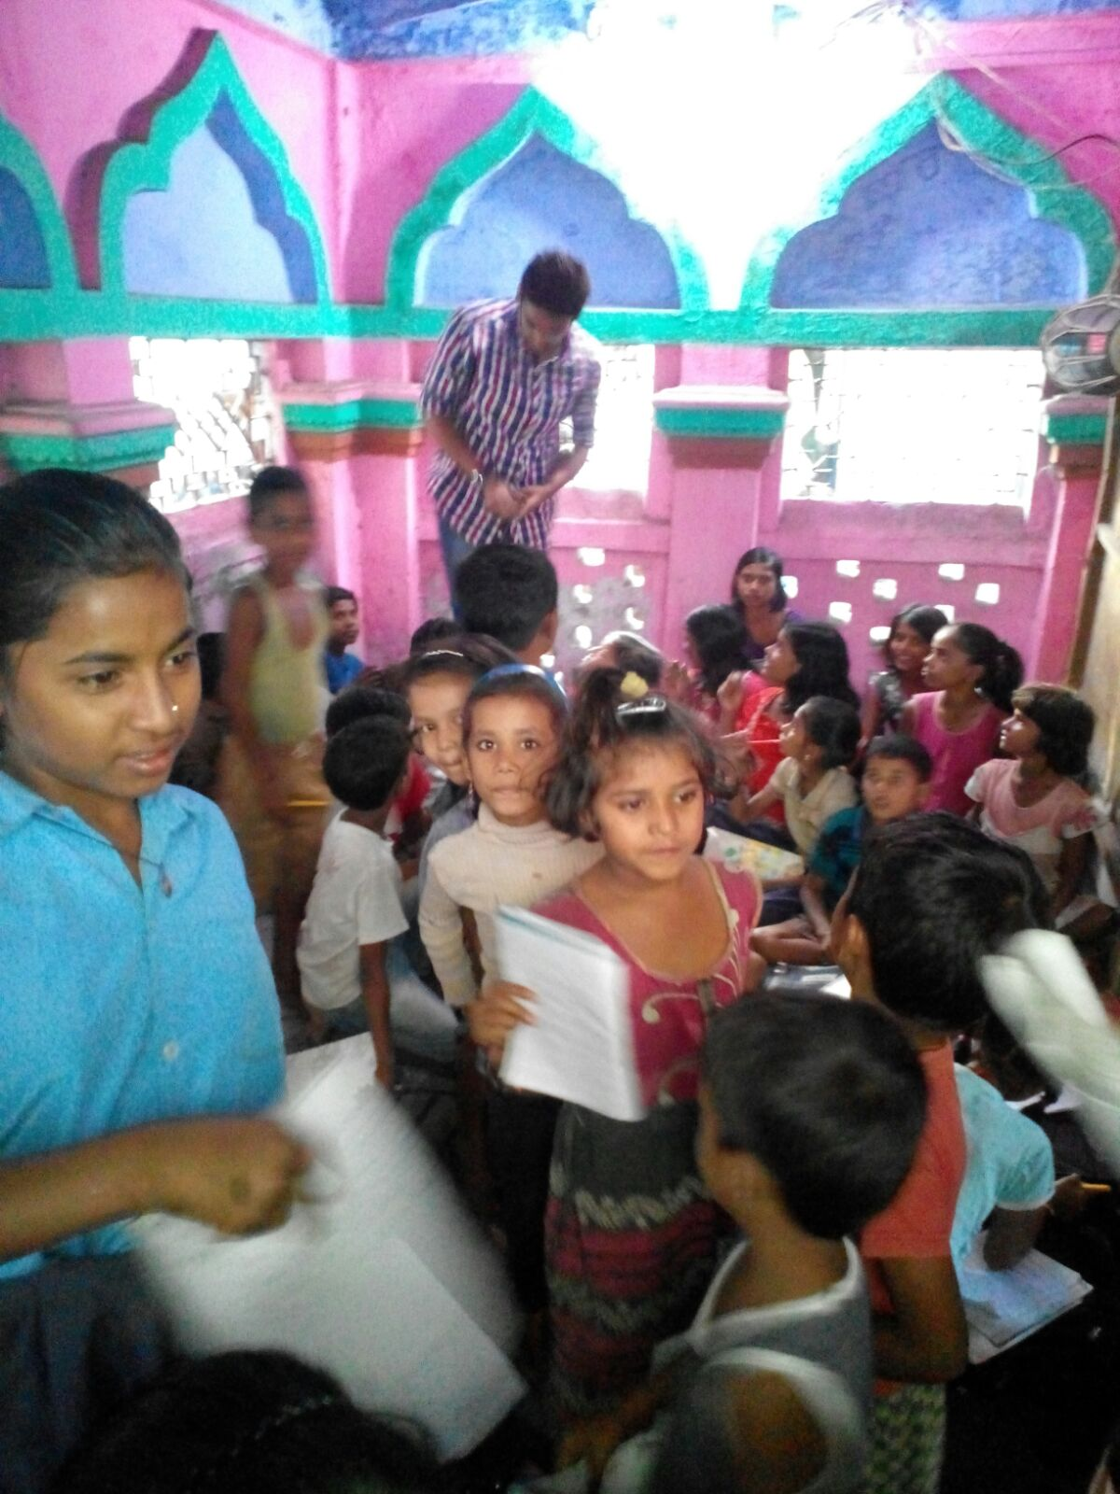
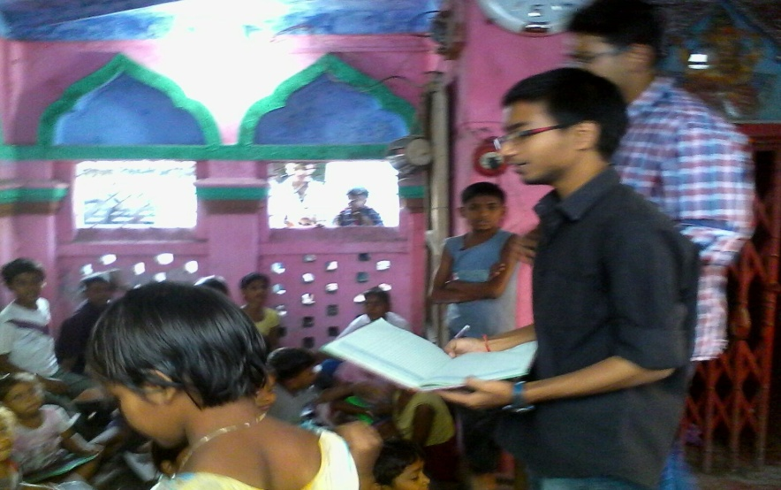

Slide 14


Slide 15
LET’S BE A PART OF THE JOURNEY
You can donate at any our centres by just making a call to Sankalp-A Pledge to Change volunteers.
All our centres are Adityapur based and run 6 days a week
You may donate books from
  Class 1-8- Course Text Books (Any Board)
  Story Books
  Unused stationery
  Any other items like bag, toys, uniforms etc.
Relevant Contact Nos. Are
  Subodh Kumar Das-9798756336
  Mayank Aggarwal -9031975746
  Suresh Pareek -7209632032
  Vikas Dixit -9472706225

Slide 16
ACCOUNT DETAILS FOR SUPPORT
Sankalp Account Details
  You can transfer funds online into our account:-
  “SANKALP” A/C No.-31114719936
  CIF No: 85757412911
  IFSC Code: SBIN0001882
  MICR Code: 831002004
  Branch code: (1882)
  Branch: SBI- RIT JAMSHEDPUR
    You may also visit our website and pay through online link available over it.
www.sankalpnitjamshedpur.org

Slide 17
“You have not lived today until you have done something for someone who can never repay you.”
www.sankalpnitjamshedpur.org

